Slide 1
Multidimensional Data Model

Slide 2
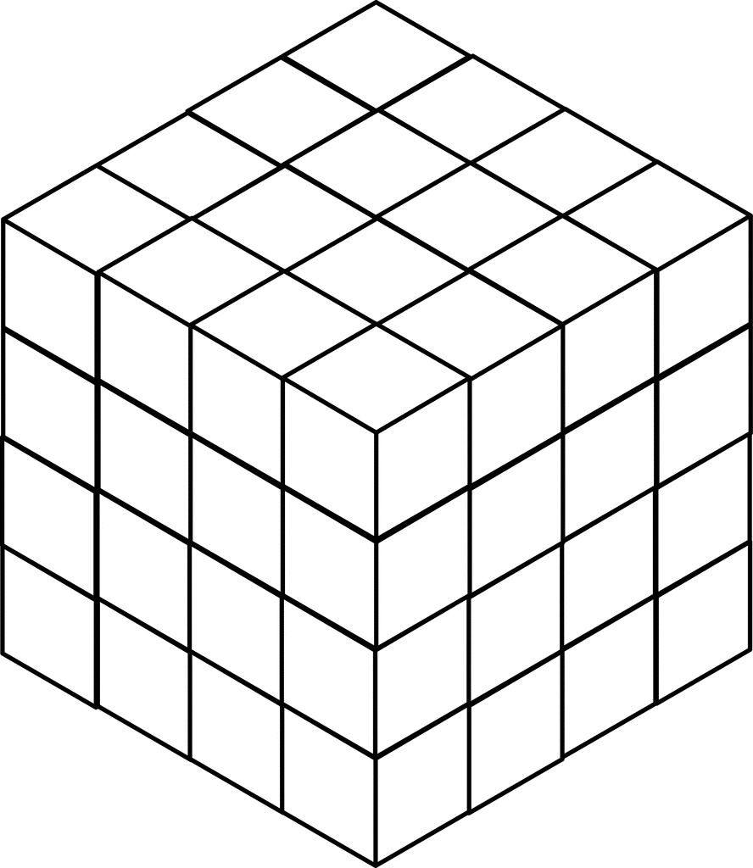
Multidimensional Data Model
This model views data in the form of data cube.
It was Developed for Implementing data warehouse and data marts.
MDDM provide both a mechanism to store data and a way for business analysis.

Slide 3
Tables and Spreadsheets to Data Cubes
A data cube allows data to be modeled and viewed in multi dimensions
It is defined by dimensions and facts

Slide 4
Dimensions
Dimensions are perspectives or entities with respect to which an organization wants to keep records
Eg These dimensions allow the store to keep track of things like monthly sale of items and the branches and locations at which the items were sold
Further each dimension may have a table associated with it called a dimension table
Dimension tables can be specified by users or experts or automatically generated and adjusted based on data distributions

Slide 5
Facts
A multidimensional data model is typically organized aroud a central theme such as sales and this theme is actually represented by fact table
Therefore facts are numerical measures for example facts for a sales data warehouse which includes
dollar_sold
unit sold
Amount budgeted etc
The fact table in this case will contain the names of the facts or measures and key for dimension tables

Slide 6
Multidimensional Data
Sales volume as a function of product, month, and region
Dimensions: Product, Location, Time
Hierarchical summarization paths
Region
Industry Region Year
Category Country Quarter
Product City Month Week
Office Day
Product
Month

Slide 7
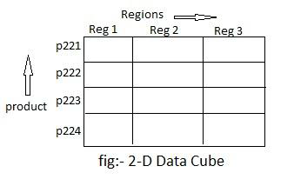
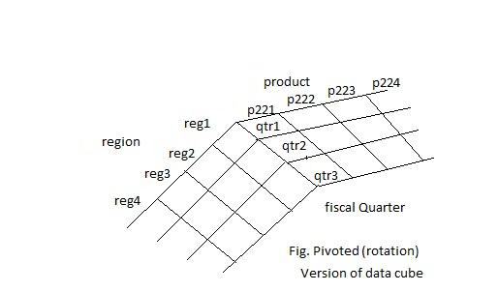
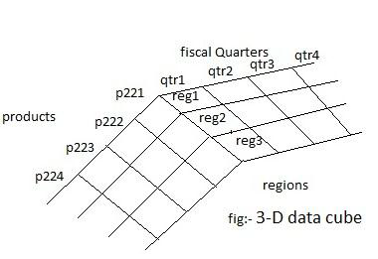
Data Cube
When data is grouped or combined together in multidimensional matrices called Data Cubes.
In Two Dimension :- row & Column or Products &fiscal quarters.
In Three Dimension:- one regions, products and fiscal quarters.
Changing from one dimensional hierarchy to another is early accomplished in data cube by a technique called piroting (also known rotation).

Slide 8
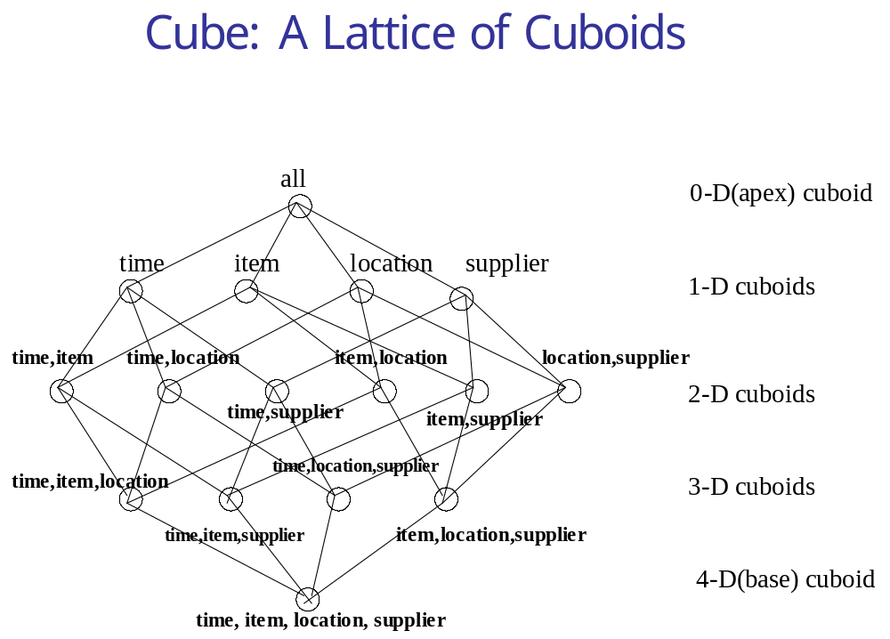

Slide 9
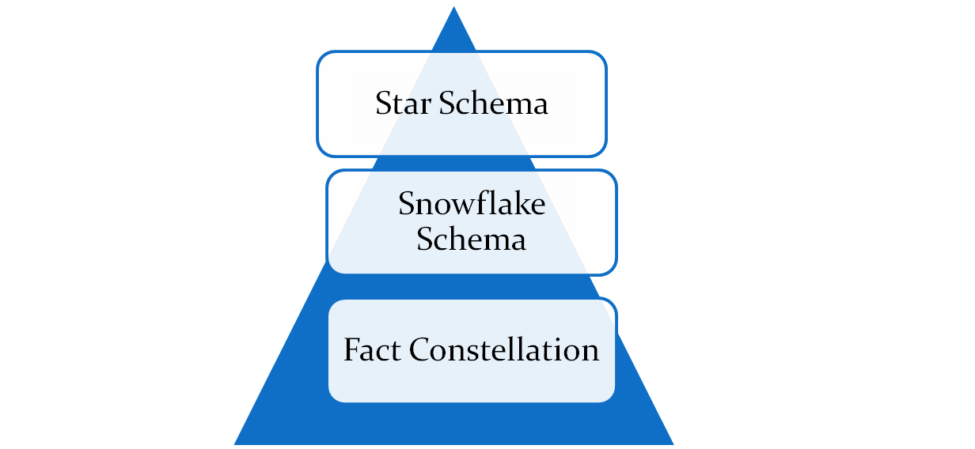
Types of MDDM

Slide 10

Star Schema
Also known as Star Join Schema
Simplest style of data warehouse schema
ERD resembles a star, with points radiating from central table
A star query is a join between a fact table and a no. of
dimension table
Each dimension table is joined to the fact table
Dimension tables are not joined to each other
A typical fact table contain key and measure

Slide 11
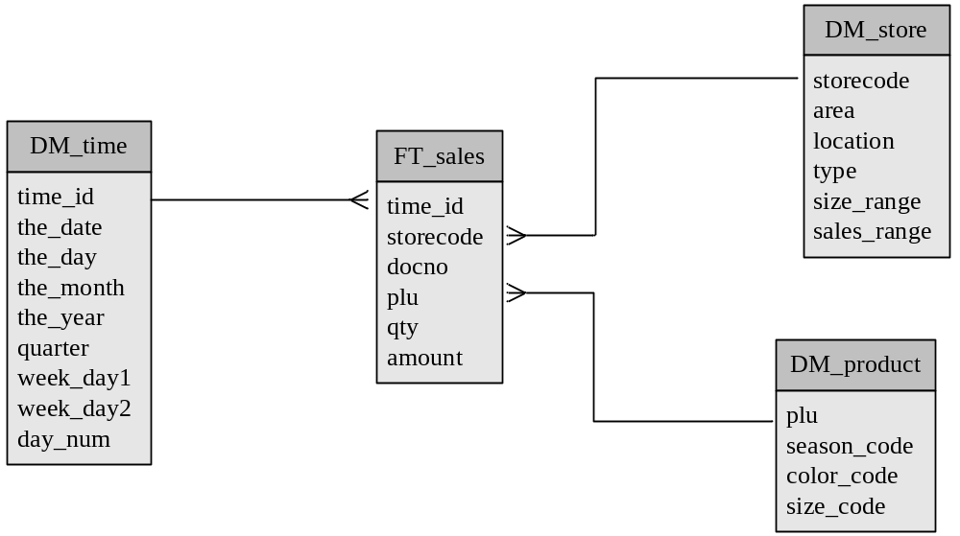
Example of Star Schema

Slide 12
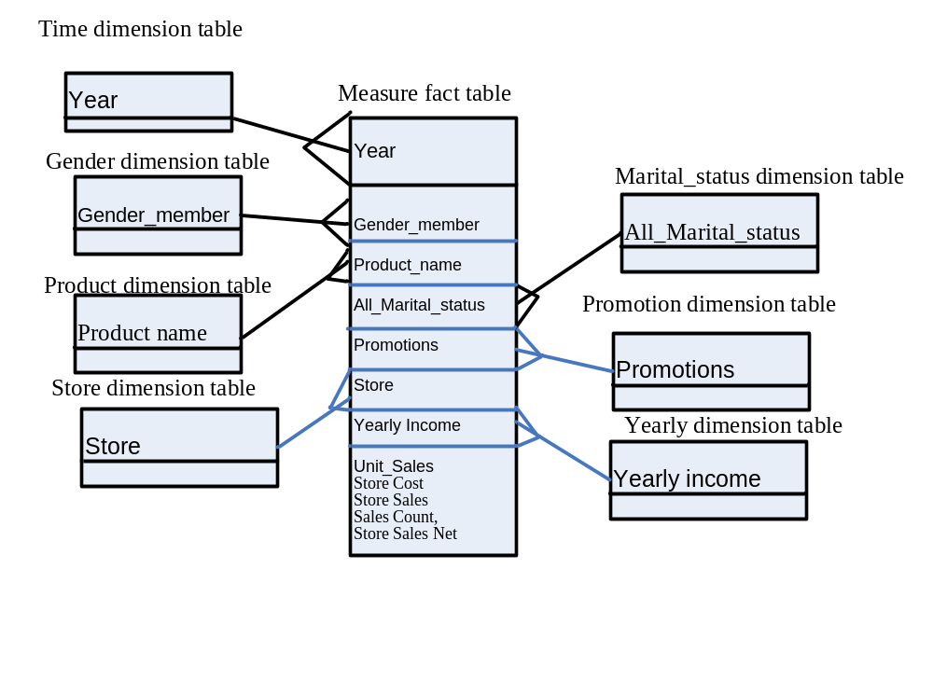
Sales Data Warehouse Star Schema of the SalesRecord

Slide 13
Sample Star Schema of Sales Record
Dimension tables:
[Gender].[Gender Members]
[Product].[Product Name]
[Marital Status].[All Martial status]
[Promotions].[All Promotions],
[Store].[All Stores],
[Store Size in SQFT].[All],
[Store Type].[All],
[Yearly Income].[All Yearly Income]
[Time].[Year]
Fact table:
[Measures].[Unit Sales],
[Measures].[Store Cost],
[Measures].[Store Sales],
[Measures].[Sales Count],
[Measures].[Store Sales Net]

Slide 14
Snowflake Schema
Dimensional tables from a star schema are organized into a hierarchy by normalizing
Snow Flake Schema is represented by centralized fact table which are connected to multiple dimensions
The Snow Flaking effecting only affecting the dimension tables and not the fact tables

Slide 15
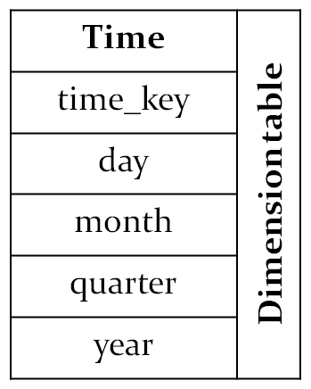
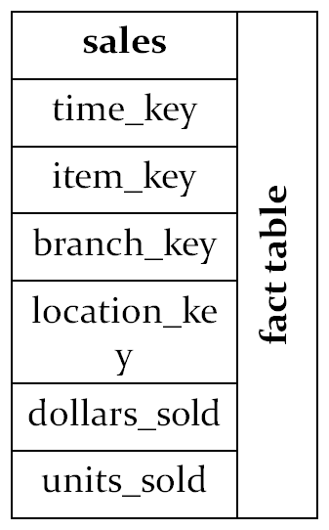
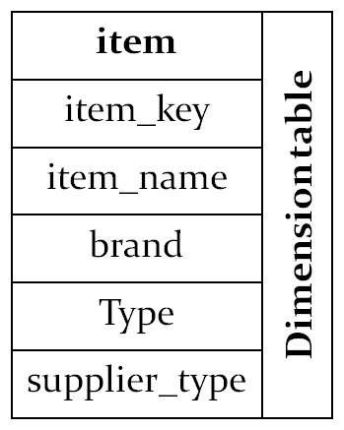
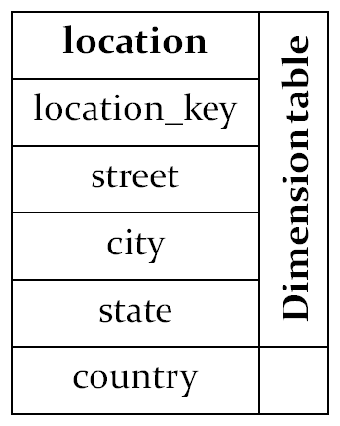
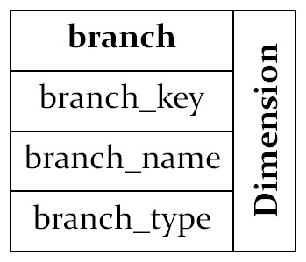
Example of Snowflake Schema

Slide 16
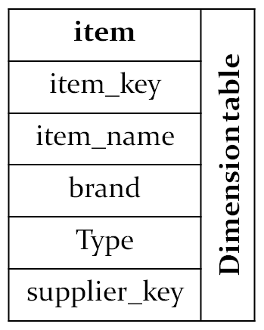
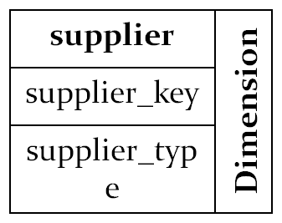
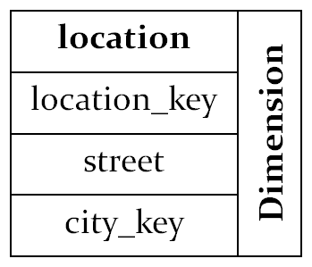
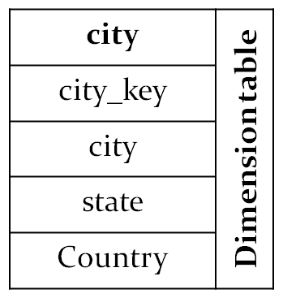
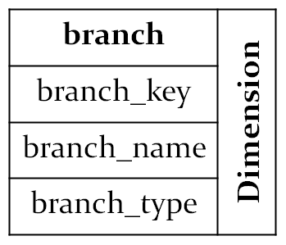
Example of Snowflake Schema

Slide 17
Fact Constellation/ Galaxy Schema
It is set of fact tables that share some dimensions tables.
It limits the possible queries for the data warehouse
Sophisticated applications may require may require multiple fact tables to share dimension tables
This kind of schema can be viewed as a collection os stars and hence is called a galaxy schema or fact constellation

Slide 18
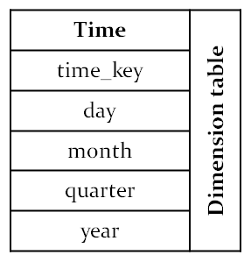
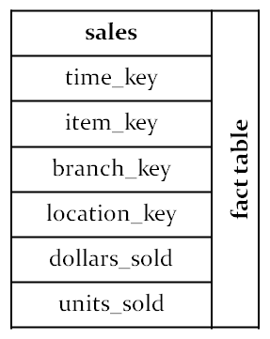
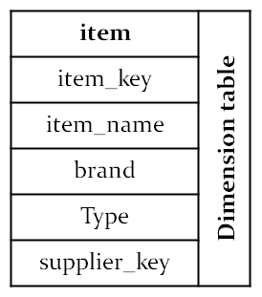
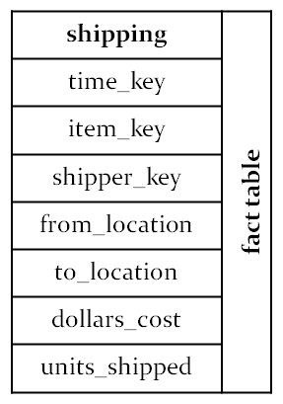
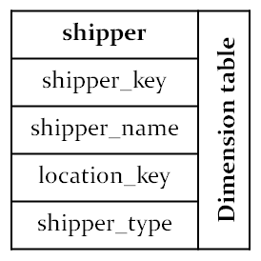
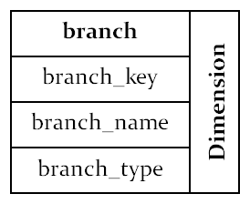
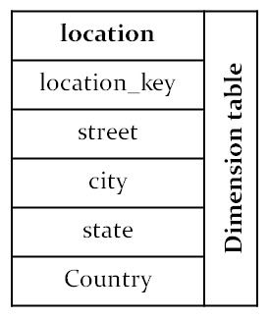
Example of Fact Constellation

